Slide 1







Stack Overflow Developer Survey
Ahmed Khalil, MBA
March 12, 2023

Slide 2



OUTLINE
Executive Summary
Introduction
Methodology
Results
Visualization – Charts
Dashboard
Discussion
Findings & Implications
Conclusion

Slide 3

EXECUTIVE SUMMARY
This presentation summarizes findings from an analysis of survey data collected from software developers on Stack Overflow.
The analysis covered the following areas:
Popular languages
Future outlooks
Demographical changes and data summary.
This report showcases the perception and future trends in various technologies.
This analysis helps identify opportunities and showcases an inventory of skillsets available in the market.

Slide 4

INTRODUCTION
Stack Overflow is a poplar website for developers.
An online survey was conducted and later open sourced by Stack Overflow.
90,000 responses.
Technology usage and future outlooks were gathered from the developers.
What are the top programming languages in demand?
What are the top database skills?
What do the demographics look like?

Slide 5

METHODOLOGY
In this research, I will be primarily using IBM Cognos to summarize the raw data findings.

Slide 6
RESULTS

Slide 7
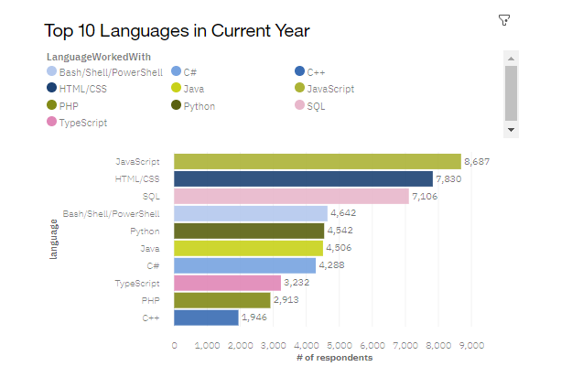
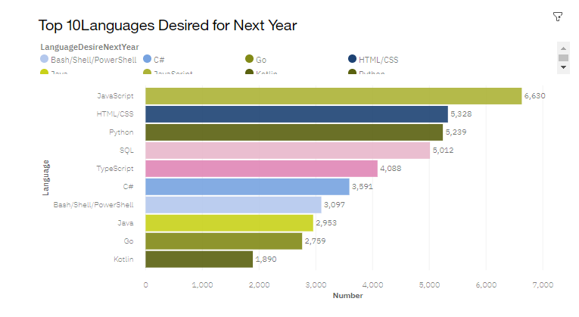
PROGRAMMING LANGUAGE TRENDS
Current Year
Next Year

Slide 8
PROGRAMMING LANGUAGE TRENDS - FINDINGS & IMPLICATIONS
Findings
Javascript and HTML/CSS were the most popular in 2019 and appears to be in demand for 2020.
Python appears to be growing in interest from 2019 to 2020.
Bash/Shell/Powershell appears to be dropping in interest year over year.
Implications
Web development appears to have a high interest and Javascript + HTML programmers will be in demand.
Python’s growing demand opens the door for more automation in the future.
These programming languages may not be used for major tasks down the line.

Slide 9
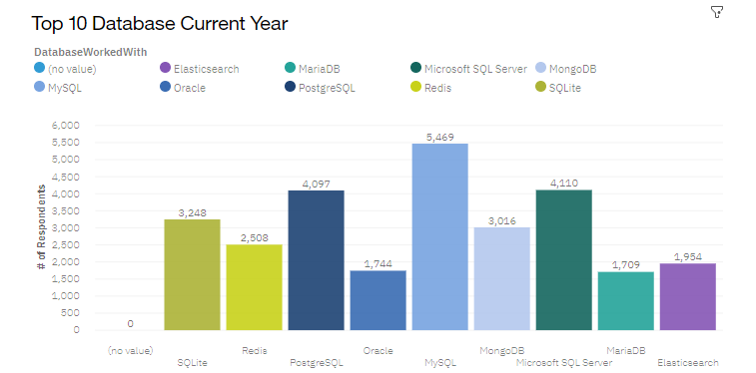
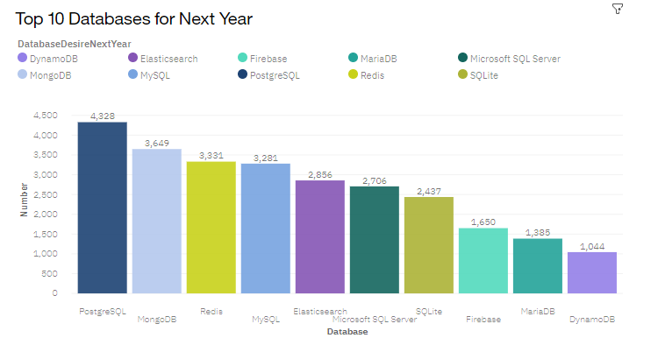
DATABASE TRENDS
Current Year
Next Year

Slide 10
DATABASE TRENDS - FINDINGS & IMPLICATIONS
Findings
MySQL is the most dominant database in 2019 and remains in the top 5 for 2020.
Postgre-SQL is increasing in demand.
MongoDB also increasing in demand.
Implications
SQL querying skills are likely to be in demand for 2020.
Relational database querying is likely to be a valuable skill in the foreseeable future.
MongoDB skills are growing in demand as well.

Slide 11

DASHBOARD
Link for the read-only dashboard:
https://dataplatform.cloud.ibm.com/dashboards/6de6dc88-e461-47e4-8a0f-0d4caa3f63af/view/6763e319398e3c9363ddc0e4079024062f342008b3bbd00b87877b4908367697a9684194c8274252df195663f5bf4051cb

Slide 12
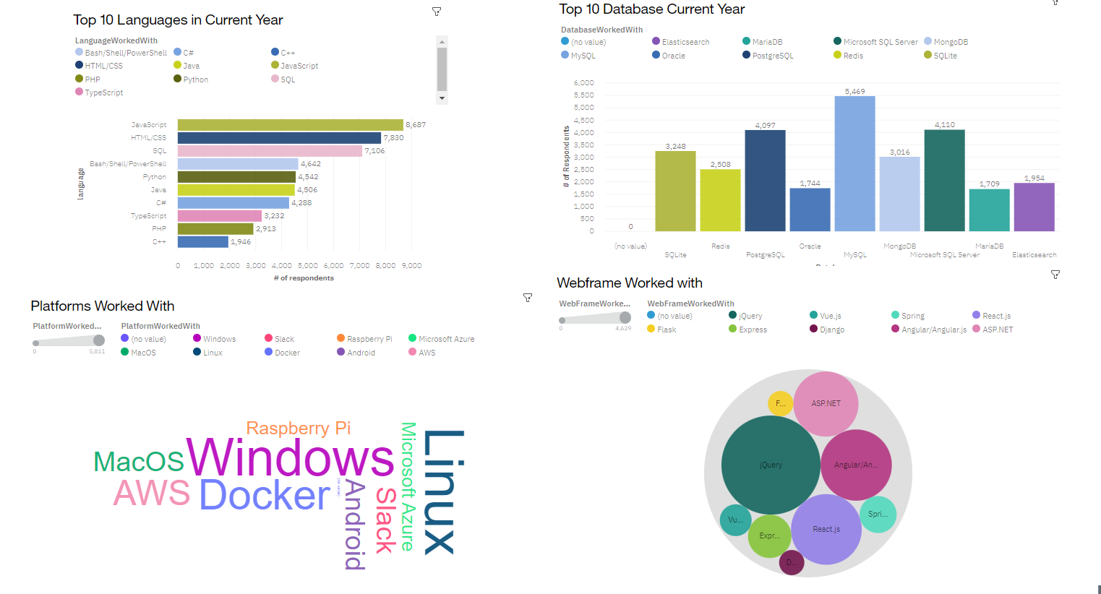
DASHBOARD TAB 1

Slide 13
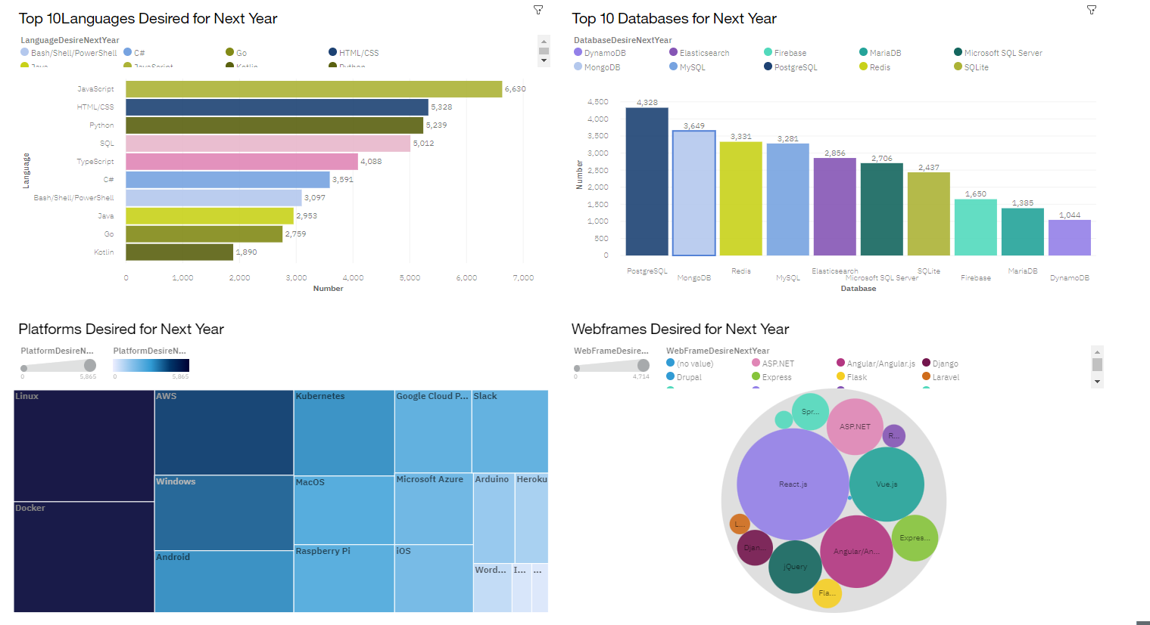
DASHBOARD TAB 2

Slide 14
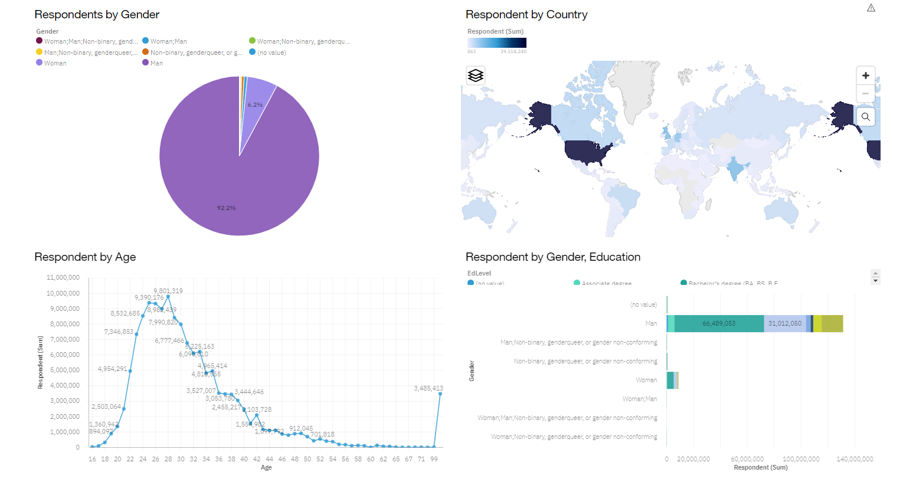
DASHBOARD TAB 3

Slide 15
DISCUSSION
The findings reveal insights to the following areas:
Which programming languages, databases and technologies are currently in the market?
Which of the above have positive prospects?
Career and educational considerations.
What is the demographic distribution of respondents?

Slide 16
OVERALL FINDINGS & IMPLICATIONS
Findings
JavaScript and HTML are dominant skillsets both in the current year and in the outlook for the next year.
SQL Remains relevant in both the current year and the next.
The current developer market is predominantly male at 92%.
The majority of developers are 24-30 years old.
Implications
The prospect for the job market in web development is positive.
Data querying skills such as SQL may prove to be valuable in the near future. Developers should think about incorporating this language into their strong existing language skillset.
Employers should try to push for more equal representation in the developer job market. Although this may not be entirely representative of the overall data.
Organizations should consider the aging of the current developer market and how age plays a role in performance, both now and in the future.

Slide 17

CONCLUSION
A 1/10 portion of the stack overflow survey data was analyzed.
Insights were generated on the current state of the developer market and what skills they believe the job market holds valuable in the future.
Demographics of the current developer market were also generated. Organizations should consider the younger population dominance as well as the male overrepresentation.

